Slide 1

Financial Transaction Dataset

Slide 2
Purpose of the project
      The purpose of this project is to use power BI to transform financial data into interactive visual dashboards that helps analyze customer profiles, card usage, and transaction behavior in an easy and visual way
      And to analyze customer, card, and transaction data to understand financial behavior , transaction patterns, credit risk , and business performance using data visualizations in power BI
This project demonstrates how power BI can be used to:
Convert large financial datasets into meaningful visuals
Monitor key financial metrics at a glance
Support data-driven decision making through dashboards

Slide 3
Objective of the project
The main objective of this project is to analyze and visualize users, card and transaction data to gain meaningful insights into spending behavior, card usage patterns, and financial trends.
By integrating users _ data, card _ data and transaction _ data the project aims to:
Understand users demographics and financial profiles
Analyze the chart types

Slide 4
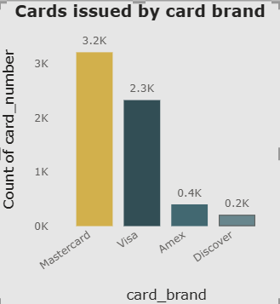
Financial Data Dashboard
Q. How many cards are issued by each card brand?
Clustered column chart
This card represents the number of cards issued by each card brand.
This clustered column chart shows the distribution of issued cards
across different card brands, highlighting that Mastercard and visa
are the most widely used brands.
In this card the Mastercard has the highest number of issued cards
(~3.2k)
Visa is the second highest (~2.3k)
Amex (~0.4k) and Discover(~0.2k) have significantly fewer cards
So, this chart indicates Master and Visa dominate card issuance
in the dataset.

Slide 5
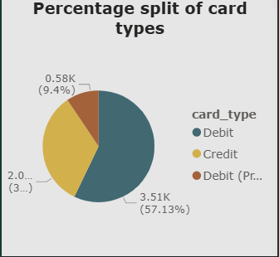
Q. What is the percentage split of card types?
Pie chart
This pie chart represents the percentage distribution of different card types in the dataset. It shows how the total number of cards is split among various card categories, such as
Debit cards
Credit cards
Debit cards (prepaid)

Slide 6
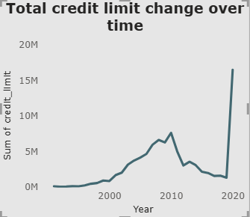
Q. How does the total credit limit change over time?
Line chart
This line chart represents the change in total credit limit over time. It shows how the sum of credit limits issued by the financial institutions has increased or decreased across different years.
The X-axis (year) shows the time period.
The Y-axis (Sum of credit _ limit) shows the total credit limit value.
The line connects yearly values to highlight the trend and fluctuations over time.
Where this chart means:
If the line is increasing -> company is issuing more credits
If the line is decreasing -> credit issuance is reducing

Slide 7
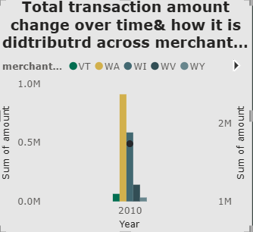
Q. How does the total transaction amount change over time and how it is distributed across merchant state?
This Line and Stacked column chart represents two things at the same time:
How the total transaction amount changes over time.
How the total amount is distributed across different merchant states.
This line and stacked column chart shows the total transaction amount over time and how it is distributed across different merchant states. The stacked columns represent state-wise contributions, while the line represents the overall transaction trend. The line appears as a point because only one year of date is currently displayed.
From this chart we are concluded that whether transactions are increasing.
Decreasing
Or fluctuating
Which state contributes more , which state contributes less.
Line and Stacked column chart

Slide 8
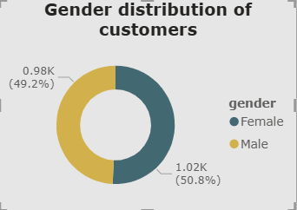
Q. What is the gender distribution of customers?
Donut chart
This donut chart represents the gender distribution of customers.
Female customers: ~1.02k(50.8%)
Male customers: ~0.98k(49.2%)
This donut chart shows the percentage-wise distribution of customers by gender, indicating an almost equal representation of male and female customers.
From this chart we conclude that The percentage of each gender.
A quick visual comparison of gender segments.
What percentage of customers are male
What percentage of customers are female
Whether the number of males and females is equal or different.

Slide 9

Q. How does the financial profile (income vs debt) change when filtering by retirement age?
This slicer represents retirement _ age from the users _ data table.
The range shown is 50 to 79
By dragging the sliders, you filter users whose retirement age falls within the selected range
This slicer is used to filter users based on retirement age, allowing interactive analysis of financial patterns across different retirement age ranges .
From this slicer we came to know that
Do people retiring early have more debt?
Do people retiring late have higher income?
Is income increasing with retirement age
Is debt decreasing for certain retirement groups?
Which retirement group is financially stronger & which group might be financially risky.
Ex: Retirement age 55 -> High debt , medium income
Retirement age 65 -> High income , low debt.
Slicer

Slide 10
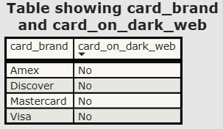
Q. Which customers have cards that are exposed on the dark web?
Table chart
This table shows the relationship between card brand and dark web exposure.
Specifically:
Card _ brand -> Type of card (Amex, Discover, Mastercard, Visa)
Card _ on _ dark _ web -> Indicates whether cards of that brand were found on the dark web (Yes / No)
This table visual displays card brands along with their dark web exposure status, helping assess potential security risks across different card types.
This table chart says that:
Which customers are at risk due to dark web exposure.
If any card is on dark _ web so certain actionable insights are taken like block those cards , inform customers , issue new cards,
strengthen the security.

Slide 11


Card charts
Q. How many customers are close to retirement?
This card shows a single key value:
433 customers are close to retirement
“close to retirement” usually means:
Customers whose current _ age is within 5 years of retirement _ age (for example: retirement _ age – current _ age <= 5)
This card visual helping to identify a key customer segment for financial planning and targeted services.
Q. How many unique clients own cards?
This card visual displays the total number of unique client cards, providing a quick overview of the overall card coverage in the dataset.
It shows 2000 unique client cards
That means:
There are 2000 distinct cards issued to clients
Each card is counted only once, even if it appears multiple times in transactions.

Slide 12



Q. How many total transactions occurred?
This card visual displays the total number of transactions, giving a quick snapshot of overall transaction activity in the dataset.
It shows 1.05M total transactions
That means:
There are approximately 1.05 million transaction records in the dataset
Every purchase, payment, or swipe is counted
Q. How many unique clients are making transactions?
This card visual represents the number pf unique clients who have performed transactions, indicating the active customer base in the dataset.
It shows 1131 unique client transactions
This means:
There are 1131 distinct clients who have performed at least one transaction
Each client is counted only once, even if they made multiple transactions
Q. What is the average credit score of users?
This card visual displays the average credit score of users, helping us quickly understand the overall creditworthiness level of the customer base.

Slide 13
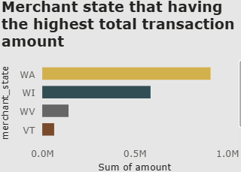
Q. Which merchant state has the highest total transaction amount?
Clustered Bar chart
This bar chart compares the total transaction amounts across different merchant states. It helps identify which state contributes the highest transaction value, with Washington(WA) leading among all states.
Here WA(Washington) has the highest total transaction amount
WI(Wisconsin) has the second highest transaction amount
WV(West Virginia) and VT(Vermont) have much lower transaction amounts
From this chart we clearly compare total transaction amount between different merchant states.
And also we understand how transaction revenue is distributed across different states.

Slide 14
Conclusion
This project analyzed users, cards, and transaction data using the power BI to gain a comprehensive view of financial activity. The users _ data provided insights into customer profiles, including age, income, debt, and credit score, helping to understand the overall financial health of users. The cards _ data helped analyze card distribution by brand and type, credit limits, and security indicators such as cards flagged on the dark web. The transaction _ data enabled analysis of transaction volume and state-wise spending patterns, highlighting regions with higher and lower transaction activity.
By integrating these three datasets, the power BI dashboards presented key summary metrics and comparisons through clear visualizations such as cards, bar charts, line charts, tables, and slicers. The analysis shows variations in customer behavior, card usage, and regional transaction performance. Overall, this project demonstrates how power BI can effectively transform raw financial data into meaningful insights that support better understanding, monitoring, and data-driven decision-making.

Slide 15
Thank You

